Slide 1
Concept of Cohesion and Coupling-

Slide 2
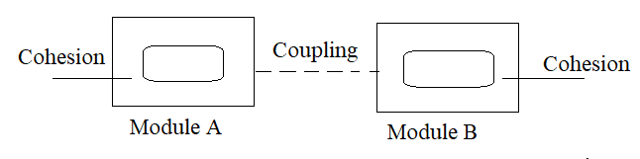
Concept of Cohesion and Coupling:-
It is a technique to divide a software system into multiple independent modules which are expected to be capable of carrying out tasks independently.
Designers
Design modules such that they can be executed and or compiled separately and independently.
Benefits testing,maintainance,independent development ,software reuse.
Modules A set of instructions put together in order to achieve some tasks.
Modules are considered as single entity but may refer to each other to work together.

Slide 3
There are measures by which the quality of a design of modules and their interactions among them can be measured and these measures are called as coupling and cohesion.
Cohesion:- It is a measure of the internal strength of a module –how closely the elements and statements of a module are associated with each other.
Coupling:-coupling is the measure of the degree of interdependence between modules.
An important characteristics of good design is to maximize cohesion and minimize coupling
Ideally each component/module should be self contained and have a few references to other modules as possible.

Slide 4
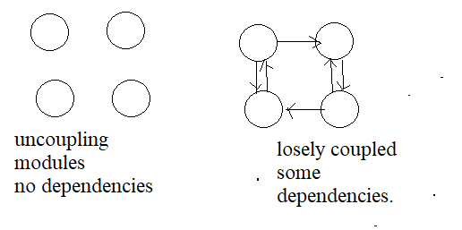
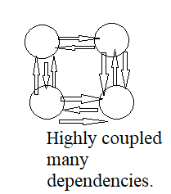

Slide 5
Cohesion:-
Cohesion measures, about how much the functionality are related to each other within the module.
Cohesion is an intra module concept.
Cohesion is a measure of functional strengths of a module.
A cohesive module performs a single task or functions (idea)
Cohesion is a measure that defines the degree of intra dependability within the element of a module.
Greater the cohesion, the better is the program design.
“Cohesion is the measure of the strengths of functional relatedness of elements within a module”
Cohesion refers to the dependence within and among a modules internal elements (eg.data,functions internal modules).
A cohesion module perform a single task within a software procedure, requiring little interaction with procedures being performed in other parts of a program.
High cohesion makes it easier to
Understand what a class or method does.
Use descriptive name
Reuse classes or methods

Slide 6
Types of Cohesion:-
Coincidental
Logical
Temporal
Procedural
Communicational
Sequential
Functional
Informational.

Slide 7
Thank you

